Slide 1
Set Up Checklist 1. Open text editor to blank folder / project 2. Install Node.js 3. Have GitHub repository open for reference: https://github.com/danielstern/ workshop-testing-linting

Slide 2

Linting and Testing Code
Workshop
Daniel Stern
Code whisperer
@danieljackstern http://github.com/danielstern

Slide 3
Use linting to improve code quality
Install and configure ESLint
Understand what linting is and how it can improve code quality
Use ESLint to improve the code quality of several applications
Use testing to find and fix errors present in codebase
Organize tests based on describe and it blocks
Fix a non-functioning application using tests
Overview of the Session

Slide 4

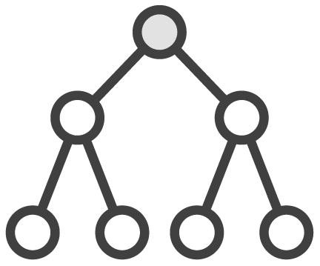

Business Objectives
Write code that can be efficiently understood and maintained
Build project that are resistant to failure by implementing high-quality tests
Create applications as a team that are as consistent as applications created by an individual

Slide 5
Q&A

Slide 6



Introductory Discussion Questions
Linting is the process of making code consistent in style. What is the importance of consistent code style among a large team?
Testing can prevent code which is not functionally correct from being pushed to production. What could the negative consequences be of pushing code which does not do what you expect it to?
Do you ever encounter hard-to-understand or maintain code while working on code written by someone else? What consequences does this result in?

Slide 7
Exploration

Slide 8
Linting Code

Slide 9




What Is Linting?
Process of analyzing source code
Warns user if code has errors / bad constructs
Usually done with tool like ESLint or JSLint
Results in consistent, stable code base

Slide 10
Categories of Problems Prevented By Linting
a ? (b ? c(b) : d(a)) : e()
let a =`hello`; a += 42;
var x=y=>n *2;
Unclear or excessively terse code
Certain types of detectable type error
Incorrect, unclear or inconsistent styling
Notes:
https://www.jslint.com/

Slide 11
Problems Not Prevented by Linting (See: Testing)
function add42(n){ return n + 43; }
let a = await b(); a += 42;
//return calcValue(z,x,y); return 42;
Logically flawed code
Type errors which cannot be easily detected
Unvisited code blocks

Slide 12
ESLint Rules
Notes:
https://eslint.org/docs/rules/

Slide 13
Demo: Linting Code

Slide 14
Code base works but is not linted
Style is inconsistent
Dangerous constructs are used
Variable names may not observe best practices
Use ESLint to determine problems with code base
Fix errors so ESLint passes

Slide 15
Testing Code

Slide 16



What is Testing?
A series of assertions about how your application runs
Programmer is alerted if any assertions fail
Executed via test runner – i.e., Jasmine, Jest, etc.

Slide 17




Why Testing?
Results in a more reliable code base
Removes assertions from actual code base
Prevents other team members from breaking / misunderstanding functionality
Verifies app is functional when it is too big to be analyzed by humans

Slide 18
function calc (a,b){ return a+b; }
describe(“Calculator”,()=>{ it(“Should add”,()=>{ expect(calc(1,2)).toBe(3) expect(calc(3,-1)).toBe(2)
expect(calc(20,22)).toBe(42) }) });
Almost any JavaScript function can be tested
Describe block is outermost container for tests
It blocks are contained inside describe blocks
It block contains assertions in the form of expect or assert
Multiple assertions can be run for each test

Slide 19
Demo: Setting Up And Writing Tests

Slide 20
Use Node to install necessary libraries for testing and configure them
Jest
Write tests for login page
Tests will check application functioning against various scenarios
Tests will be functional outside of browser setting
Notes:
https://developers.google.com/web/fundamentals/primers/modules

Slide 21
Application Testing / Linting a Problematic Codebase

Slide 22
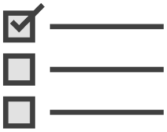


Application
Codebase for standard MVC app is provided
Code is riddled with stylistic errors – use ESLint to find the errors and fix them
Code has flawed logic and errors – use testing to find these errors and fix them

Slide 23
TodoMVC application has already been written
Business tasks can be assigned a priority
Tasks are sorted based on priority
Tasks can be completed and added like in a standard Todo list
Application must be linted
Configure ESLint and modify code until no errors are thrown
Modifying .eslintrc can be a valid solution
Application must be tested
Individual functionality of the app must be tested with Jest
Add items, complete items, sort, change priority, etc.
Rendering of app onto page does not need to be tested

Slide 24
Reflection

Slide 25



Group Discussion
Testing allows us to contribute to large and complex applications. Have you ever worked on an application that was too big for a single person to understand? What problems did you encounter? How do you think testing can help with these issues?
Linting contributes to cooperative group work. In what ways do you think Linting code helps us work together as a team?
When we write code, it is often maintained later by someone else. In what ways can you help the person who will be maintaining your code in the future, by applying what you have learned about linting and testing?

Slide 26
Linting is a professional code quality technique
Allows us to write and maintain code of high quality
Standardized code style across many developers
Can help avoid certain types of bugs
Testing is a powerful time-saving tool
Prevents other developers from breaking code
Alerts us to errors in the logic of our code
Acts as an important warning system for large-scale applications
Summary

Slide 27
Learn More About Testing With This Course
Write tests for a full-scale React application
Learn about advanced testing features
Mocks
Snapshot Testing
Gain real-world testing skills
https://app.pluralsight.com/library/ courses/testing-react-applications-jest
Testing React Applications with Jest

Slide 28
Questions? Comments? Other feedback?

Slide 29
Thank You!

